Slide 1
Machine Learning in Biomedical Informatics BMI507 Spring 2019
Sarah Mullin

Slide 2
Review

Slide 3
f(x)=1/10
0 10
MIT research: http://clinicalml.org/research.html

Slide 4
Areas Machine Learning Has Been Beneficial:
Classification of medical images
Phenotyping: Identifying a patient in a cohort (patient could be a candidate for a clinical trial, they may benefit from a different treatment regime based on other patients like them)
Diagnostic testing: outcome prediction for future diagnosis, mortality, length of stay, etc.

Slide 5
Medical Image Classification
Litjens G, Kooi T, Bejnordi BE, Setio AA, Ciompi F, Ghafoorian M, van der Laak JA, van Ginneken B, Sánchez CI. A survey on deep learning in medical image analysis. Medical image analysis. 2017 Dec 1;42:60-88.
Notes:
Precision medicine: predicting tissue outcome on an individual patient basis using machine learning algorithms to combine multiparametric MRI

Slide 6
Image Classification: Pathology
Benign tubules (red) are organized and similar
Deep Learning can provide clear boundaries (Green= higher likelihood that a pixel belongs to the tubule class)
Malignant tubules (red) variance is large
Deep Learning is able to identify large portion of associated pixels, but provides incorrect labeling in situations where traditional structures are not present
Janowczyk A, Madabhushi A. Deep learning for digital pathology image analysis: A comprehensive tutorial with selected use cases. Journal of pathology informatics. 2016;7.

Slide 7
Cohort Identification

Slide 8
Cohort Identification
They show that CNNs outperform concept extraction based methods in almost all of the tasks, with an improvement in F1-score of up to 26 and up to 7 percentage points in area under the ROC curve (AUC).

Slide 9
Statistics versus Machine Learning
Statistics draws population inferences from a sample
Machine learning finds generalizable predictive patterns
Statistics: long data—tons of subjects
Machine Learning: wide data– tons of features
https://www.nature.com/articles/nmeth.4642

Slide 10
Types of Machine Learning
Supervised: samples of input-output pairs (labelled outcomes)
Regression and Classification
Semi-Supervised: supervised learning tasks and techniques that also make use of unlabeled data for training
Unsupervised: draw inferences and patterns from input data without labelled output data
Clustering, PCA
Reinforcement: machine tries a bunch of different things and is given a reward signal when doing something well

Slide 11
Notes:
Use deep learning for large n , ML for small; feature engineering—ML need to be identified by expert, DL try to learn high-level features from data;process: ML divide problems into steps: object detection, then recognition; DL: end to end; TIME: DL long time bc so many parameters; INter

Slide 12
Notes:
Use deep learning for large n , ML for small; feature engineering—ML need to be identified by expert, DL try to learn high-level features from data;process: ML divide problems into steps: object detection, then recognition; DL: end to end; TIME: DL long time bc so many parameters; INter

Slide 14
Types of Machine Learning
Supervised: samples of input-output pairs (labelled outcomes)
Regression and Classification
Semi-Supervised: supervised learning tasks and techniques that also make use of unlabeled data for training
Unsupervised: draw inferences and patterns from input data without labelled output data
Clustering, PCA
Reinforcement: machine tries a bunch of different things and is given a reward signal when doing something well

Slide 15
Classifiers: Assigning observation to a category
Generative: build a statistical model that generates all values for an event/phenomenon (both observed and “target” variables)
Generate both inputs and outputs given hidden parameters
Examples: Gaussian Mixture Model, Hidden Markov Model, Naïve Bayes, Generative adversarial networks
Discriminative: directly estimate a decision rule/boundary, provide a model only for target variables, generating them by analyzing observed variables
Infer inputs based on outputs
Examples: Logistic Regression, Support Vector Machines, Neural Networks
Notes:
Generative models are used in machine learning for either modeling data directly (i.e., modeling observations drawn from a probability density function), or as an intermediate step to forming a conditional probability density function. Generative models are typically probabilistic, specifying a joint probability distribution over observation and target (label) values. A conditional distribution can be formed from a generative model through Bayes' rule.

Slide 16
Classifiers: Assigning observation to a category
Notes:
Generative models are used in machine learning for either modeling data directly (i.e., modeling observations drawn from a probability density function), or as an intermediate step to forming a conditional probability density function. Generative models are typically probabilistic, specifying a joint probability distribution over observation and target (label) values. A conditional distribution can be formed from a generative model through Bayes' rule.

Slide 17
Background on Machine Learning
Target/Label: Output
Features: Input
Patients (N)

Slide 18
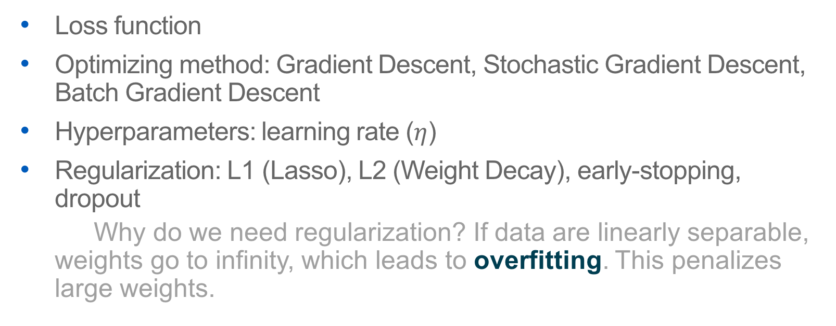
Machine learning algorithms:
Loss function
Optimizing method: Gradient Descent, Stochastic Gradient Descent, Batch Gradient Descent
Hyperparameters: learning rate ($η$)
Regularization: L1 (Lasso), L2 (Weight Decay), early-stopping, dropout
Why do we need regularization? If data are linearly separable, weights go to infinity, which leads to overfitting. This penalizes large weights.

Slide 19
Optimization
Minimizing/maximizing a function f(x) by altering x
f(x) is the objective function: loss function, cost, error
Example: Least Squares
Done many ways: usually stochastic gradient descent, gradient descent, or batch gradient descent
Notes:
Choose eta to be small of line search, brent’s method

Slide 20
What is overfitting?
Overfitting refers to a model that models the training data too well.
Overfitting happens when a model learns the detail and noise in the training data to the extent that it negatively impacts the performance of the model on new data. This means that the noise or random fluctuations in the training data is picked up and learned as concepts by the model.
This is bad for new data and generalizability!
Underfitting: can neither model the training data nor generalize to new data
What you want: Select a model in between overfitting and underfitting!

Slide 21
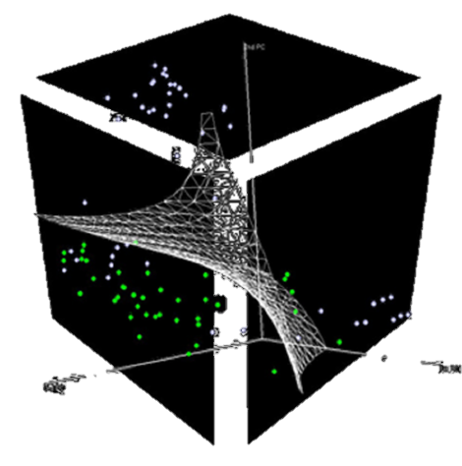
Interpretability: What is it?
Machine Learning Algorithms, like decision trees, give us rules for why one thing was chosen over another—easy to interpret reasoning behind it. We can extract our features from logistic regression for the most “important” features
Deep Learning:
Notes:
P(X>5)=(10-5)*1/10=.5 P(X=5)=0 there is no probability at 1 point for continuous distributions!

Slide 22
Interpretability: Visualization and Exploratory Analysis
‘informativeness,’ where an interpretation of the model, such as why a diagnosis was made or what risk factors influence classification into a high risk category, can help clinicians make informative decisions
post-hoc interpretations about what additional information a model can provide and simultaneous modeling to check interpretation
NOT the inner workings of the model
can visualize feature maps, find ‘importance measures,’ attention
Notes:
The attention mechanism allows us to find the importance of each encounter for prediction by analyzing the attention scores, where large attention scores indicate high probability of importance to the predicted state.

Slide 23
Clinical Decision Support: Working with EHR data
high dimensionality
Millions of records
Not just patients that specifically fit the strict inclusion/exclusion criteria of clinical trials or cohort studies
Potentially, algorithms could deliver decision support using EHR data in the patient’s record AT THE POINT OF CARE

Slide 24
Complexities of Electronic Health Record Data
Heterogeneous data types:
Coded diagnoses (ICD-10)
Coded procedures (CPT)
Medications (RxNorm)
Lab Values (Continuous, have different labels)
Vital Signs
Image Data (X-Rays, Pathology slides, radiography images, etc.)
Temporal Components (Admission, Discharge Dates)
Clinical Text (non-codified data)
Demographic Information (Age, Gender, Birthdate, Zip Code, Address, Marital Status, Occupation)
Insurance Information

Slide 25
Complexities of Electronic Health Record Data
Longitudinal
Many encounter dates with irregular time gaps within patient and within system
De-identified data only gives you access to a year and not the full date
Missing Data
There is no uniform way to collect data items—features/variables may be missing
Patient may switch systems, insurance companies, or providers—gap in their patient encounters and history

Slide 26
Issues with using EHR data for Supervised Learning (Classification)
Training data is expensive
annotation of images is resource intensive (cost of experts, time)
semi-supervised approach can augment training data using unlabelled images
Training data may be imperfect
wrongly labelled—using ICD-10 as labelled diagnosis could introduce bias
may not include all necessary components of EHR –interoperability, labs, imaging may not be included to confirm diagnosis

Slide 27
Decision Trees
Internal nodes correspond to features
Leafs correspond to classification outcome
Edges denote assignment
Continuous variables have to be discretized/thresholded

Slide 28
Best features?
Looking for a good criteria for selecting the best feature for a node split
Entropy: Quantifies the amount of uncertainty associated with a specific probability distribution
The higher the entropy, the less confident we are in the outcome
Information Gain: How much do we gain (in terms of reduction in entropy) from knowing one of the features
Finding the Best feature will return the feature that maximizes the information gain at each node

Slide 29
Decision Trees: Drawback
Algorithm runs out of features
This is dangerous: For datasets with many (non relevant) attributes the algorithm will continue to split nodes
This will lead to overfitting!

Slide 30
Avoiding overfitting: Tree pruning
Split data into train and test set
Build tree using training set
- For all internal nodes (starting at the root)
- Remove sub tree rooted at node
- assign class to be the most common among training set - check test data error
- if error is lower, keep change
- otherwise restore subtree, repeat for all nodes in subtree

Slide 31
Random Forest: Ensemble Methods
Collection of decision trees
For each tree we select a subset of the features and build the tree using just these features
An input sample is classified using majority voting

